Slide 1
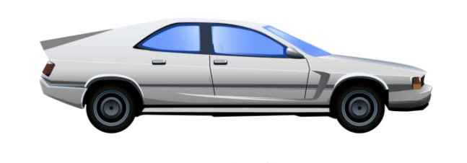
Car Sales And Market Analysis
Complete Analysis Report
Date: 29 August 2025

Slide 2
Dataset Summary
Total Cars
50000
Total Brands
10
Total Fuel Type
05
Total Model
10

Slide 3
Trends

Slide 4
Popularity & Pricing

Slide 5
Depreciation & Profitability
Brand | Model
Hyundai | Innova
Honda | XUV500
Toyota | Escort
Honda | City

Slide 6
Transmission Type: Sales & Pricing Trends

